Slide 1
Equality and Diversity: Realising all of our potential Gary Loke Head of Policy, ECU

Slide 2
Our work
Equality Challenge Unit (ECU) works to further and support equality and diversity for staff and students in higher education institutions across the UK and in colleges in Scotland.

Slide 3
Equality and diversity
What does equality and diversity mean to you

Slide 4
Examples
I am not from Edinburgh ….this means that right now I find travelling around Edinburgh confusing …. so I need clear instructions about how to get to places and maps.
I have a young child …. this means that I am less flexible with my time than other students …. so I need to work with people who stick to plans and show up on time.

Slide 5
Equality in the law
Age
Gender
Race
Religion and belief (including no belief)
Sexual orientation
Disability
Marriage and civil partnership
Gender Identity (trans people)
Pregnancy and maternity

Slide 6
In-groups and out-groups
Factors of influence might be:
physical characteristics (for example, age, gender, race)
shared interests and hobbies (for example, sport, music, gardening)
similar lifestyle (for example, having children, caring responsibilities or pets)
similar background (for example, being from the same place, having a similar family background, having studied at the same institution)

Slide 7
In-groups and out-groups
We have natural tendencies to prefer people who are like us
In-groups are people that we feel safer and more comfortable around and who we may treat more favourably
Out-groups are people that we feel less safe and comfortable around and who we might treat dismissively or disdainfully

Slide 8
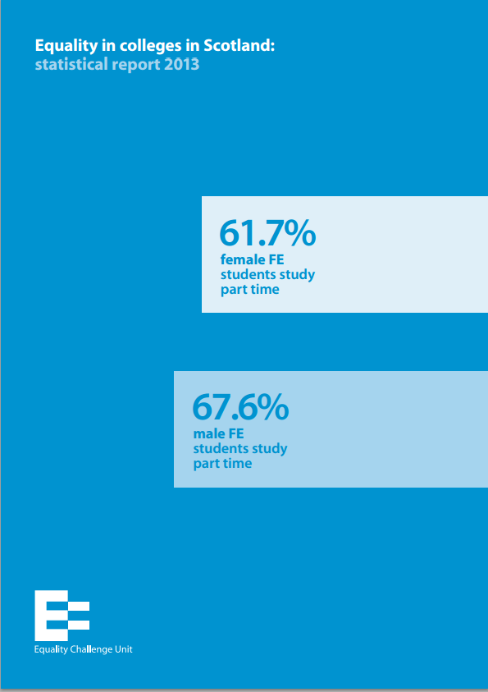
What do we know?
http://www.ecu.ac.uk/wp-content/uploads/external/equality-in-colleges-in-scotland-statistical-report-2013-print-version.pdf

Slide 9
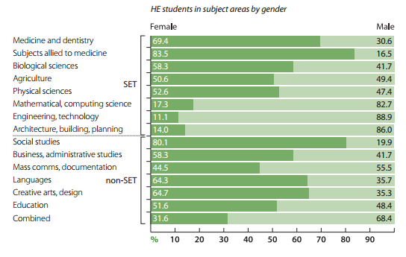
Gender

Slide 10
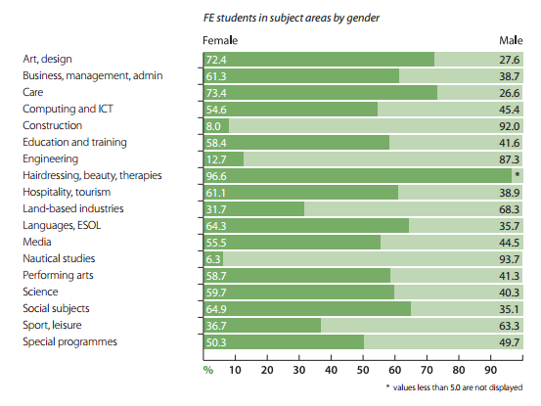
Gender II

Slide 11
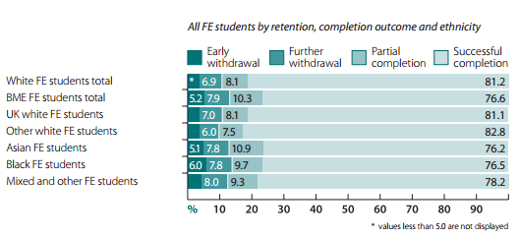
Ethnicity
Completion; subject choice; mode of study

Slide 12
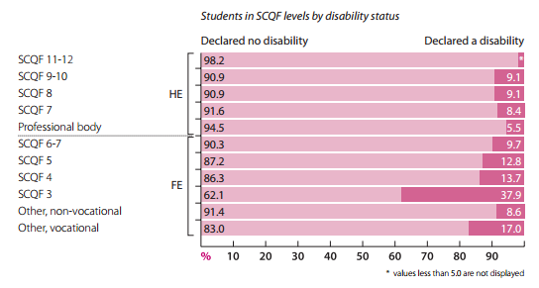
Disability
Level of study; subject choice; completion

Slide 13
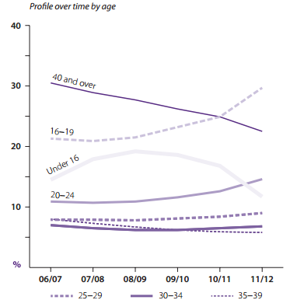
Age

Slide 14
Scottish Funding Council letter of guidance 2015-16
Strategic objectives:
Access to education for people from the widest range of backgrounds and better learner outcomes
Wood report challenges – vocational education; addressing youth unemployment
Gender balance on boards and in participation
Part-time study and bursaries/childcare support

Slide 15
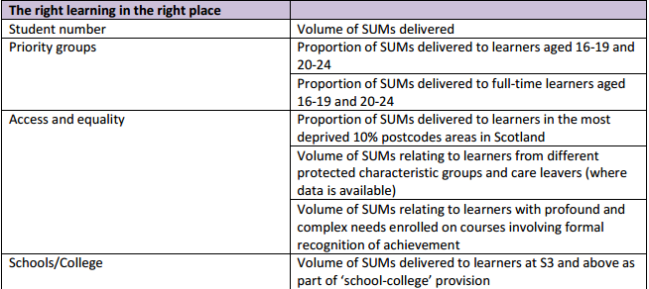
Outcome agreements

Slide 16
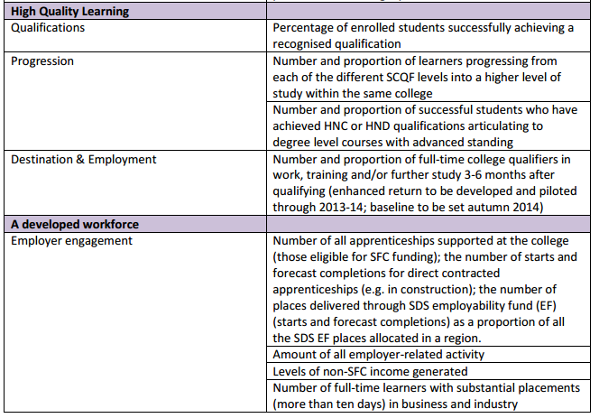
Outcome agreements II

Slide 17
Equality Act 2010: Equality Outcomes
Culture – promoting equality, diversity and inclusion, fostering good relations, safeguarding health and wellbeing
Mainstreaming and embedding
Collection, understanding and use of data
Staff journey
Student journey
Accessibility and meeting needs

Slide 18
What can you do?

Slide 19
Contact
Gary.loke@ecu.ac.uk
@ECU_Gary
www.ecu.ac.uk

